Slide 1
1 CORINTHIANS

Slide 2
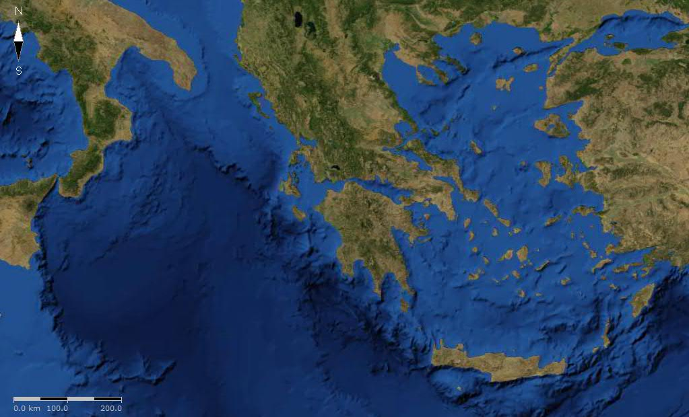
1 CORINTHIANS
Ionian
Aegean
Corinth
Achaia

Slide 3
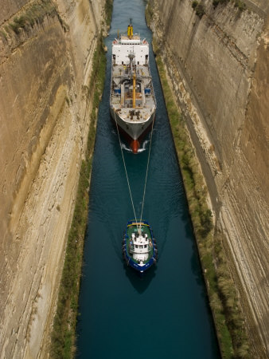
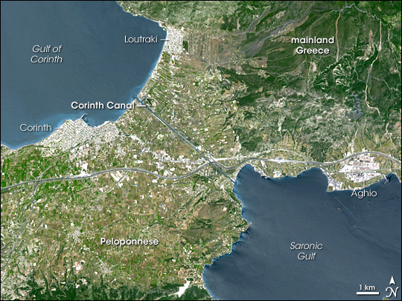
1 CORINTHIANS
3.9 mi
Corinth Canal

Slide 4
1 CORINTHIANS
Korinthiazomai ~ to commit fornication

Slide 5
1 CORINTHIANS
Leaves Corinth for Ephesus (Acts 18.18)
Paul writes 1 Corinthians
Paul writes 2 Corinthians
AD51
AD53
AD55
AD57
Paul wrote 1st letter (now lost) from Ephesus (1 Cor. 5.9)
Paul's "sorrowful" letter (now lost) (2 Cor. 2:4
Paul arrives at Corinth and founds church
(Acts 18.1)
1st letter being misunderstood, the church sends delegation to Paul w/ specific questions (1 Cor. 16:17)
Paul's "hasty" visit (2 Cor. 2:1
Paul’s “Corinthian Timeline”

Slide 6
1 CORINTHIANS
1-4) Division within the church
5-6) Church discipline
7) Marriage, divorce and celibacy
8-10) Doctrinal disputes
12-15) Misunderstanding of doctrinal issues

Slide 7
1 CORINTHIANS
Peri dei ~ Now concerning …

Slide 8
1 CORINTHIANS
Chapters 1-4 ~ “wise” and “wisdom” occurs 29x

Slide 9
1 CORINTHIANS
“If you love Jesus, TITHE (any idiot can honk)”

Slide 10
1 CORINTHIANS
Watch ~ grēgoreō - to take heed lest through remission and indolence some destructive calamity suddenly overtake
one

